Slide 1

Project Preview Presentation
Cportfolio – Team 2
This Photo by Unknown author is licensed under CC BY-SA.

Slide 2

Introduction
Easy to use stock and crypto holding portfolio with market trend data.
Our platform is suitable for new investors as well as experienced investors. Making it suitable for anyone to use easily even for when they are using it for the first time or to use quickly.
An easy to use and modern interface is more appealing to the audience which is new to the crypto market and is like other systems that they are accustomed to use in their daily life.
This Photo by Unknown author is licensed under CC BY.

Slide 3

Agenda
Project Briefing
01
Agile, Sprints, UML Diagram and ERD Diagram
02
Java code, Project Closing
03
This Photo by Unknown author is licensed under CC BY-NC.

Slide 4

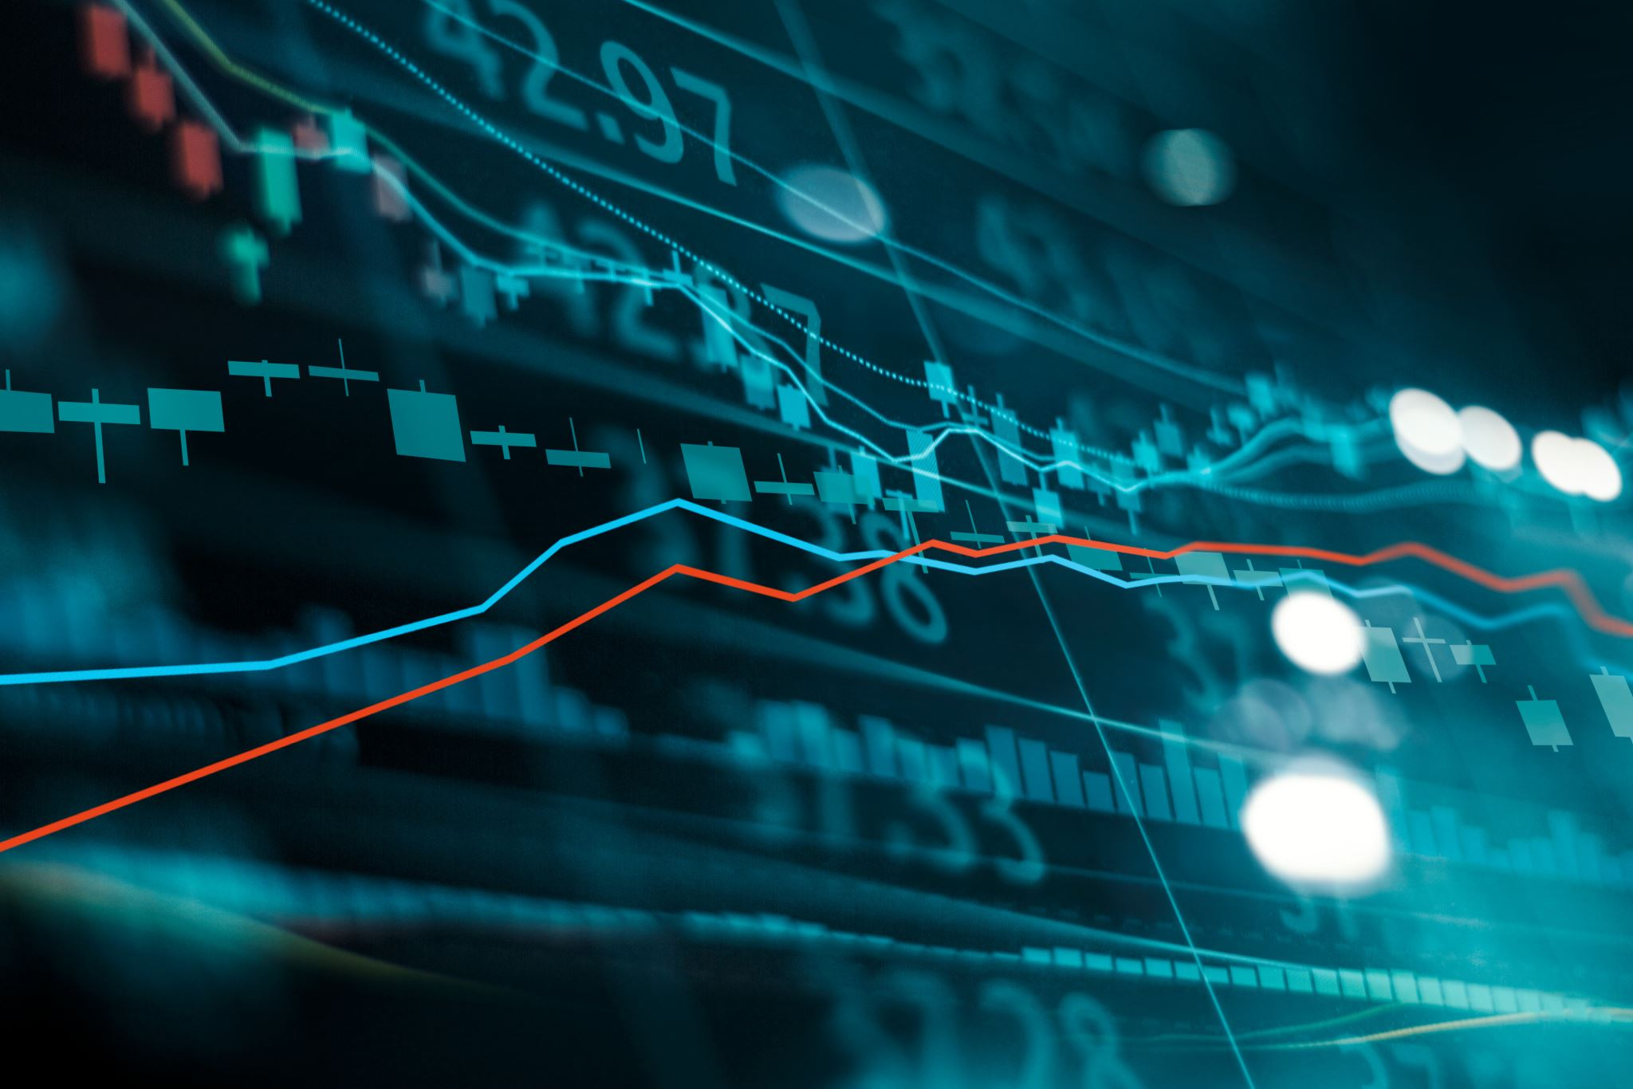
Project Summary
The project is focused on assisting experienced/rookie traders on the crypto and securities market to keep a track of their portfolios and utilize to make their next trade.
The data related to various cryptocurrencies and securities will be sourced from APIs which facilitate a secure and reliable way of acquiring that data.
This data will be displayed in the application and will be used to create a portfolio dashboard for the user.
Apart from this, time series data of the prices will be used to feed machine learning models to generate speculations and predictions as to what will happen next.
These processes would be done for both crypto currencies as well as conventional securities.
This Photo by Unknown author is licensed under CC BY-ND.

Slide 5
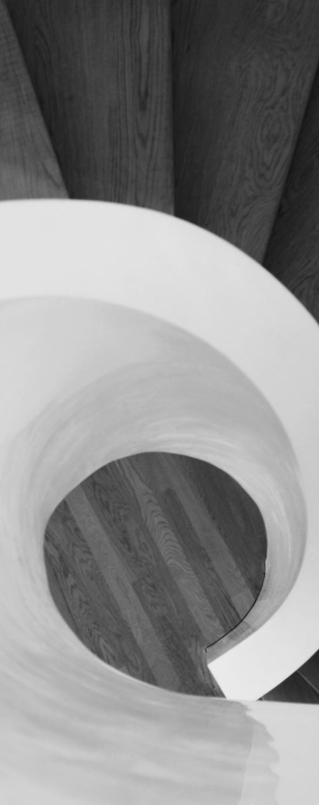
Agile
Planned each sprint according to submission of deliverables and decided what to accomplish in the following sprint.
Synced all team members on the same page and made everyone vocal about any concerns that may block the progress.
Had a meeting after every sprint to check the progress and found out what all is accomplished.
Met after the end of each sprint to talk about what worked well and what didn’t, so we could improve the process moving forward. This is called the Retrospective.

Slide 6
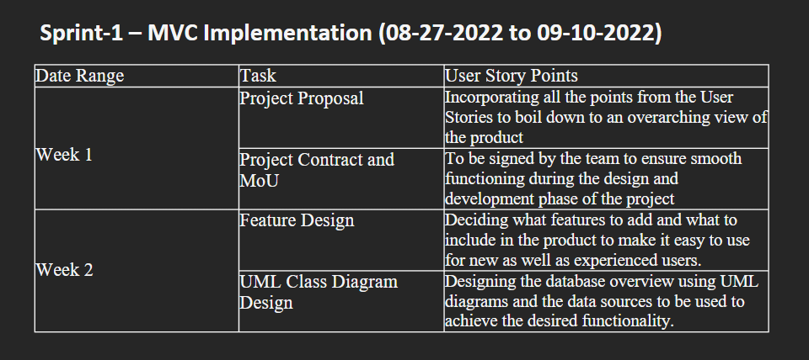
Sprint 1

Slide 7
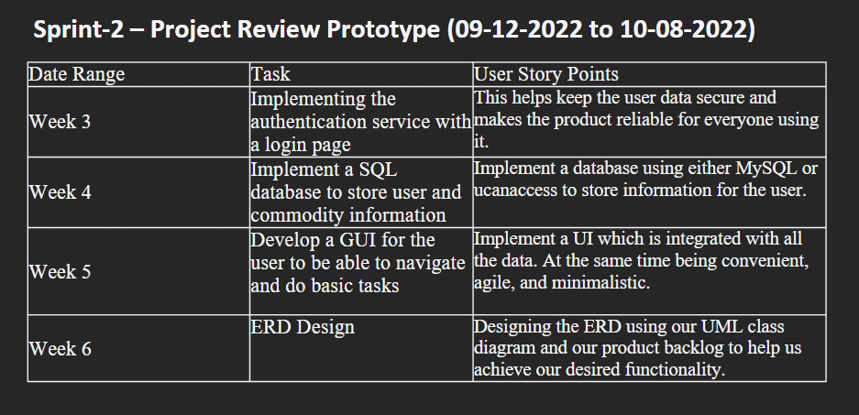
Sprint 2

Slide 8
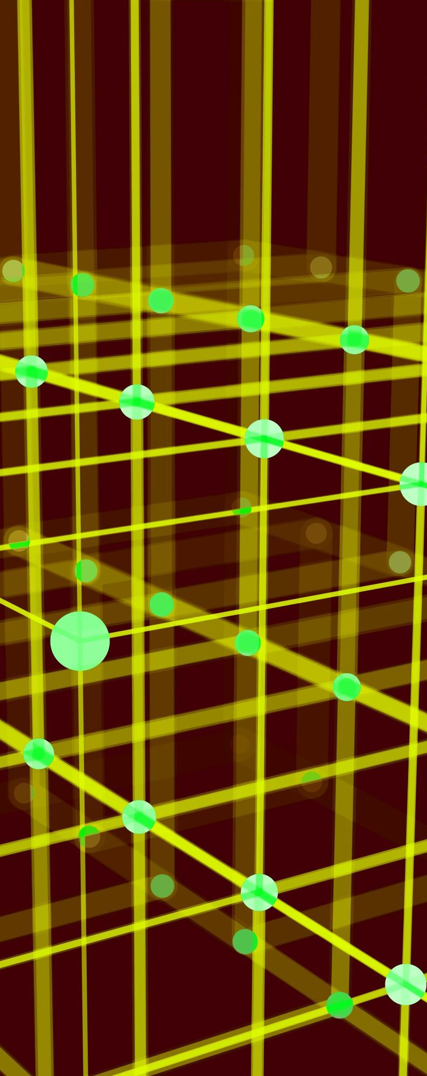
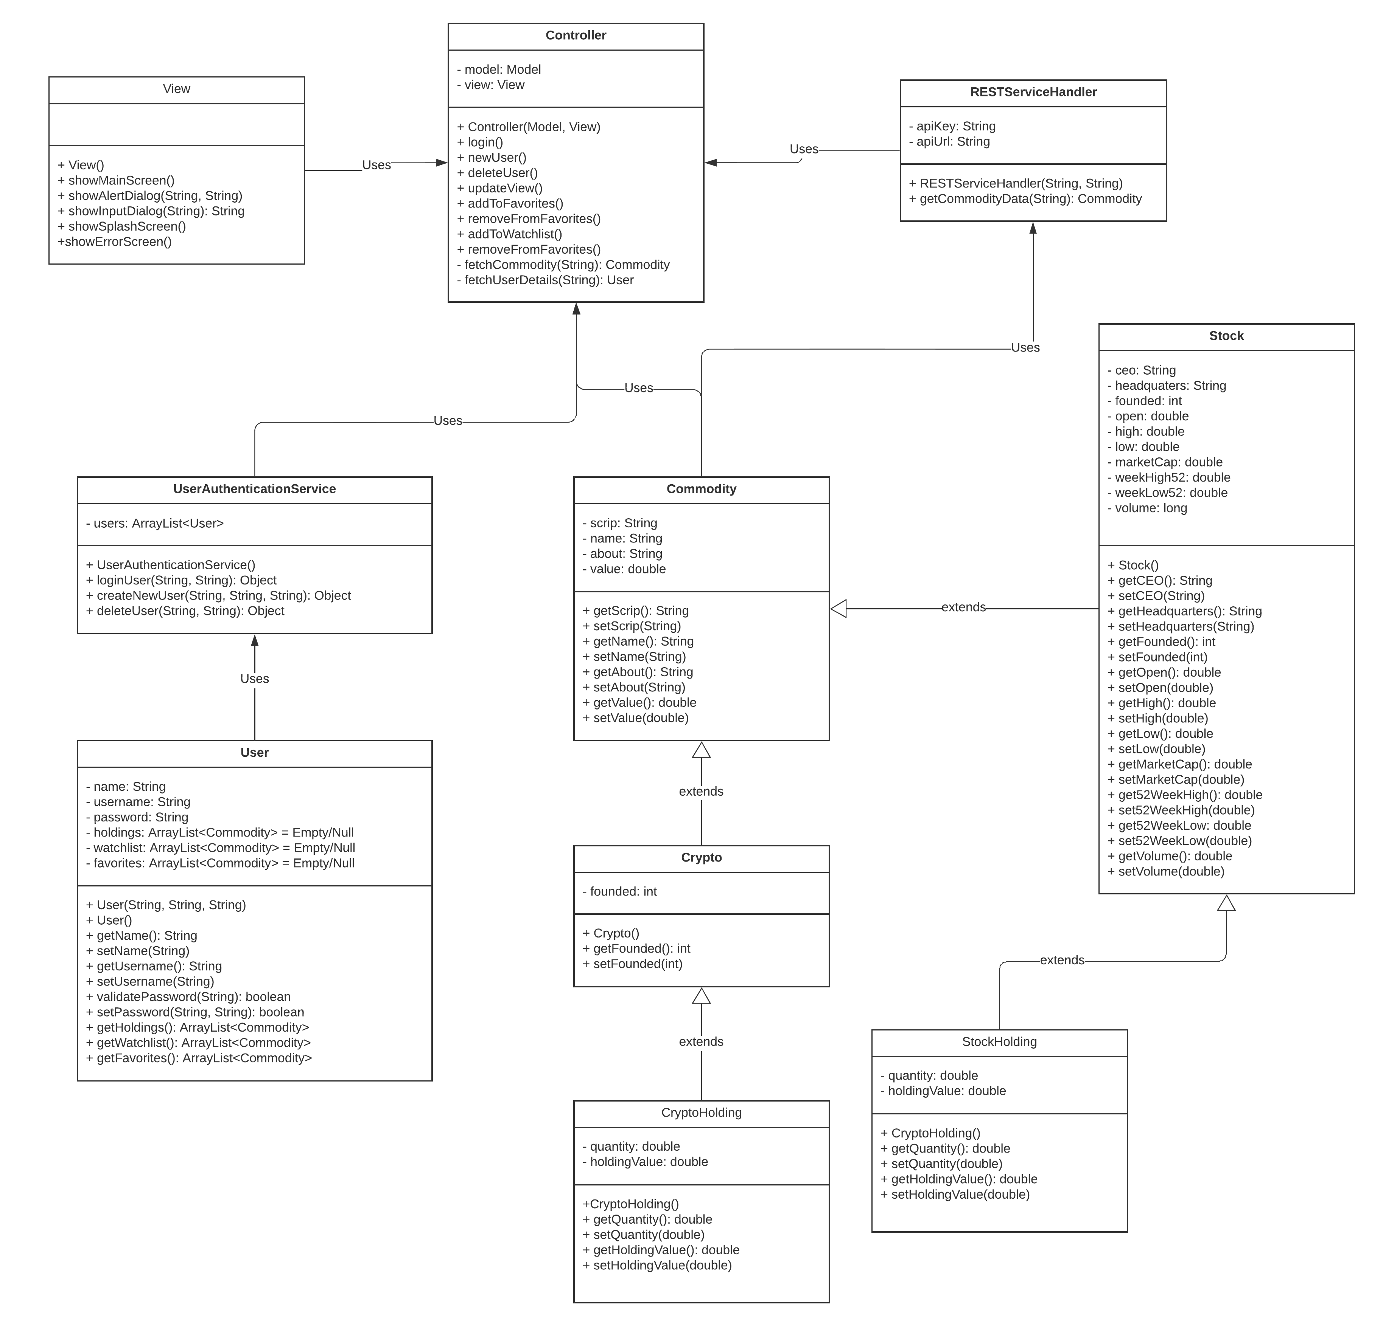
UML Diagram

Slide 9
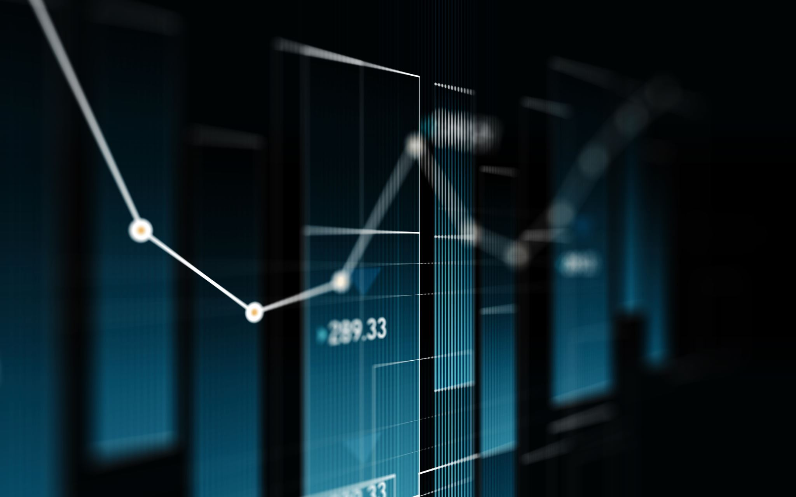
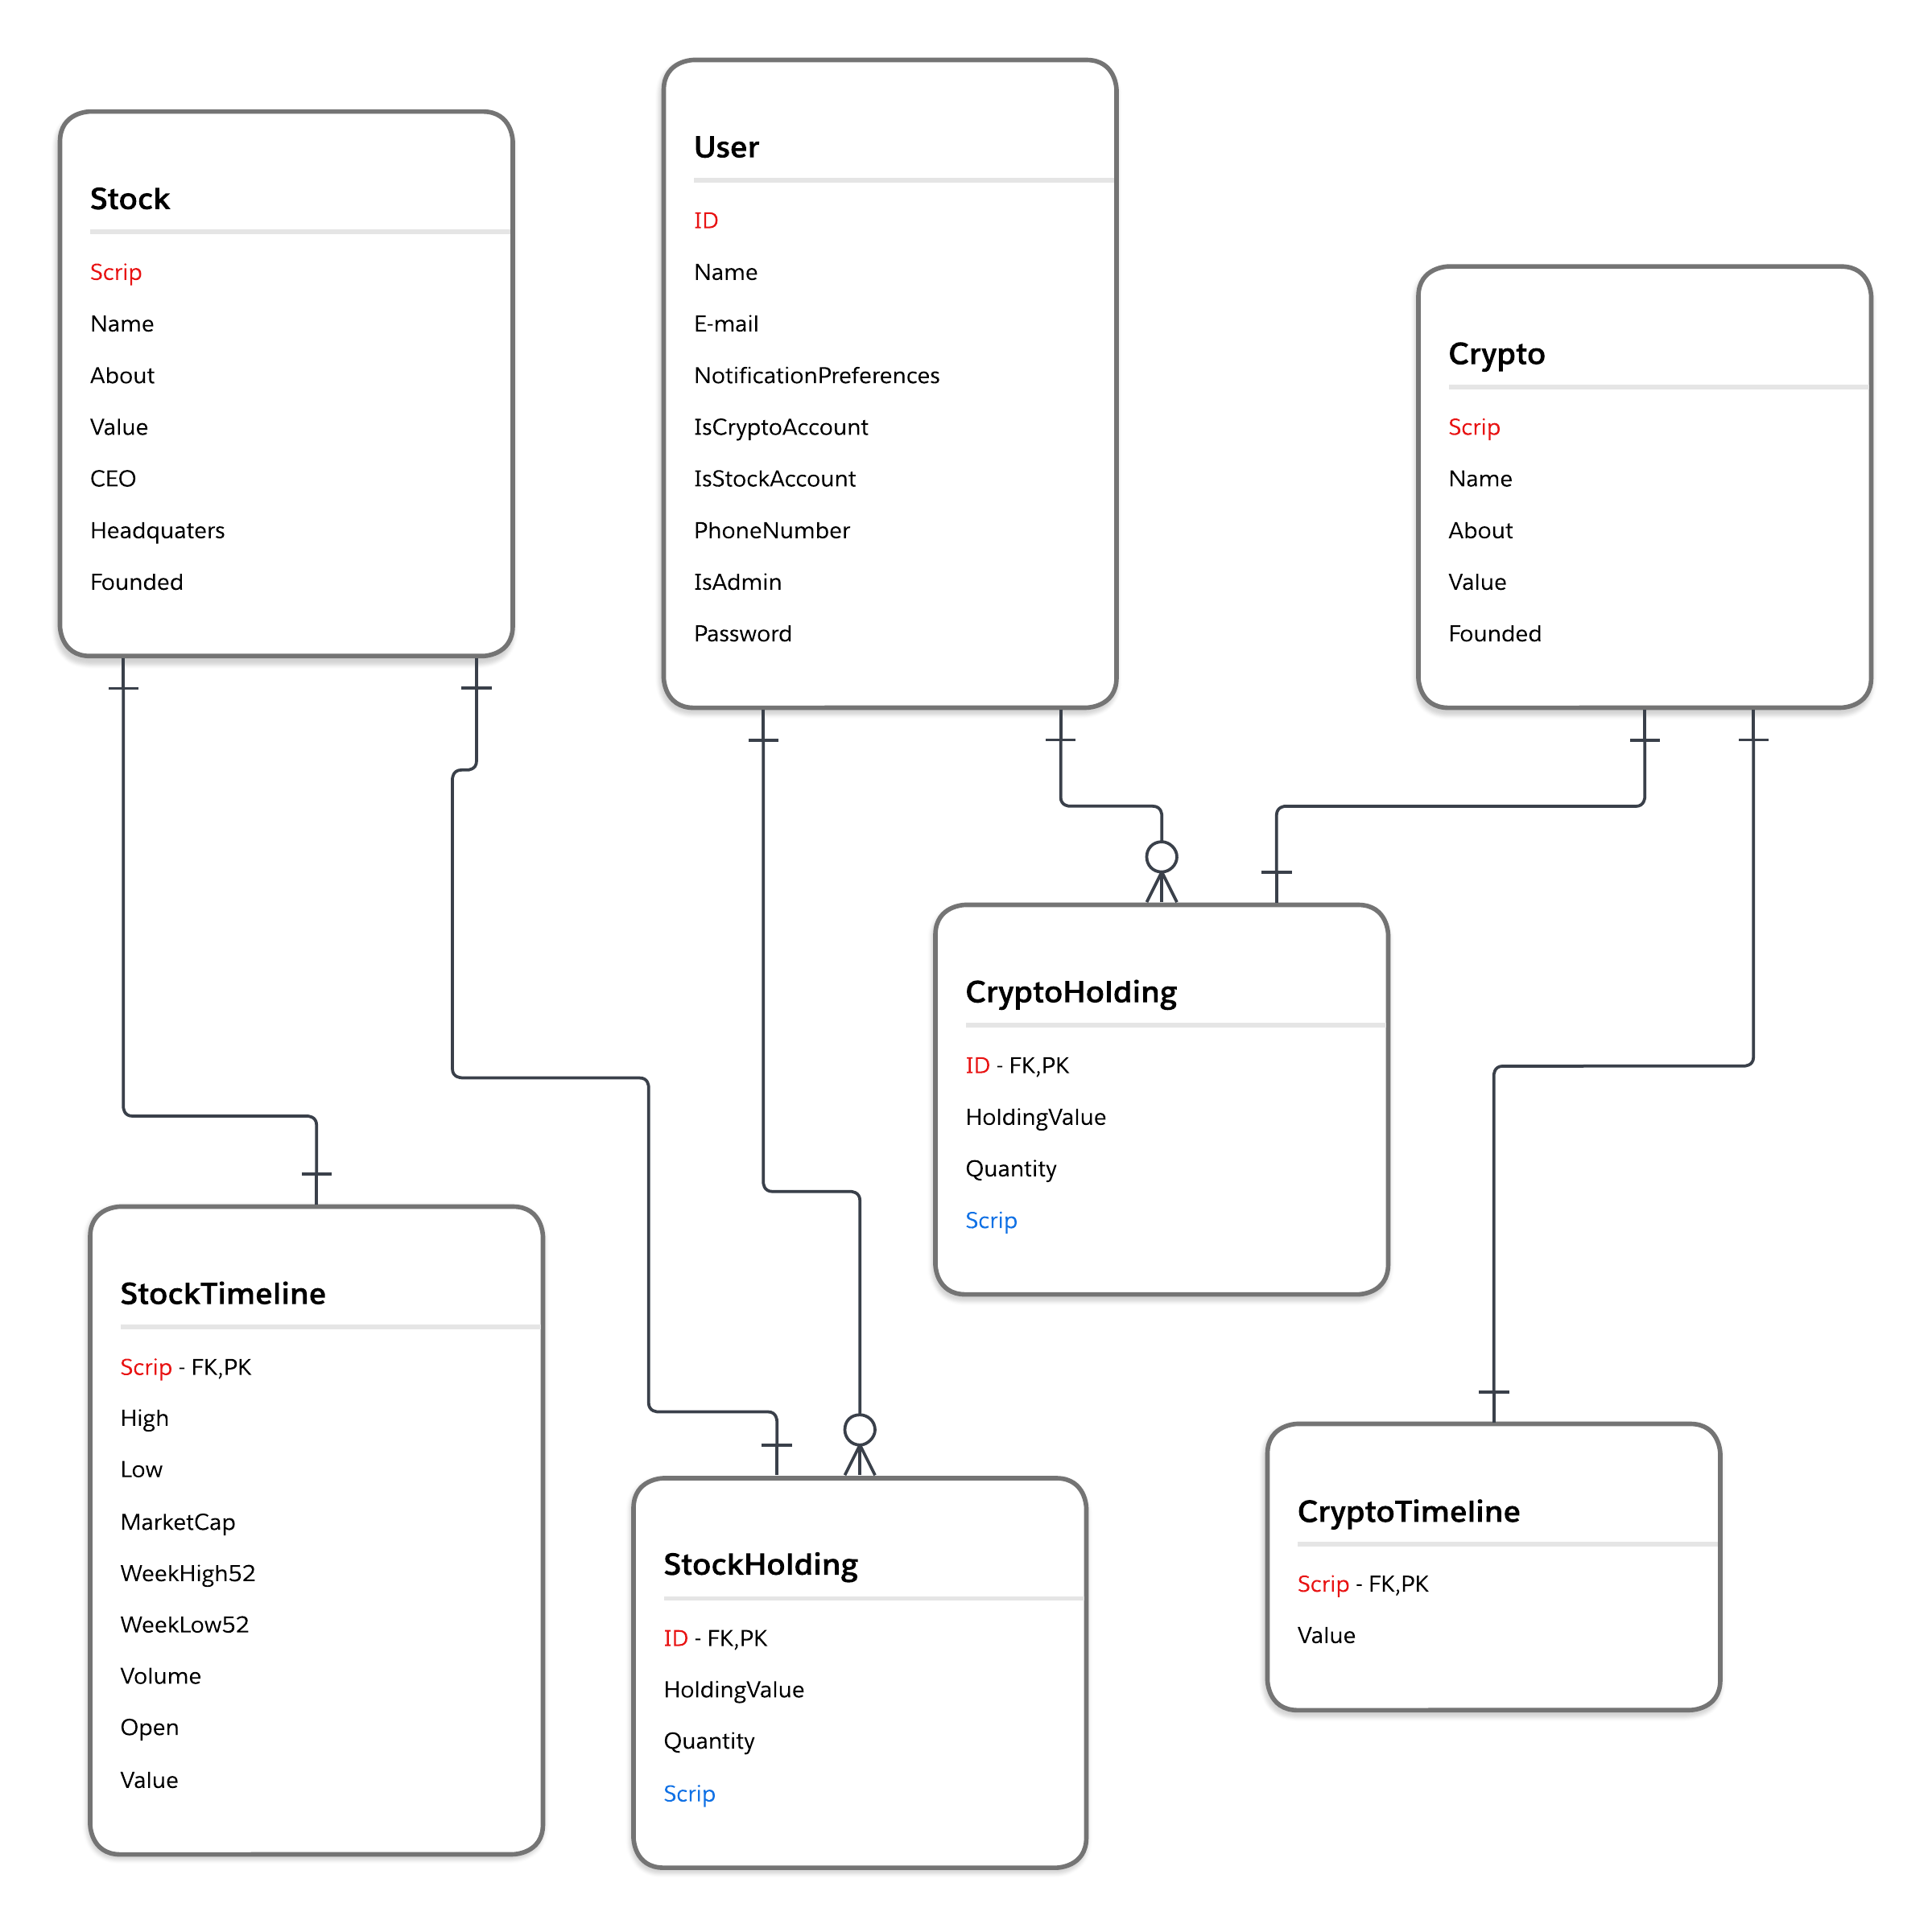
ERD Diagram

Slide 10
Java Code
Presenting in Class.

Slide 11
Project Closing
Creating an intuitive graphical UI.
Completing the database with the remaining tables.
Connecting to the API to fetch the required values.
Debugging and Testing.
Documentation.

